Slide 1

The Power of News Analytics: Uncovering Business Value
Krishna Khandelwal
S1364040
Assignment- 02

Slide 2
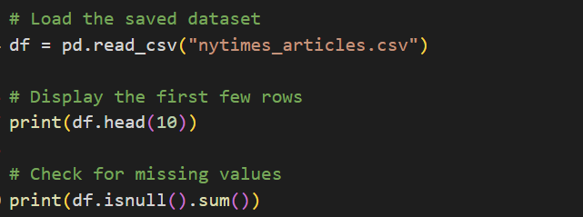
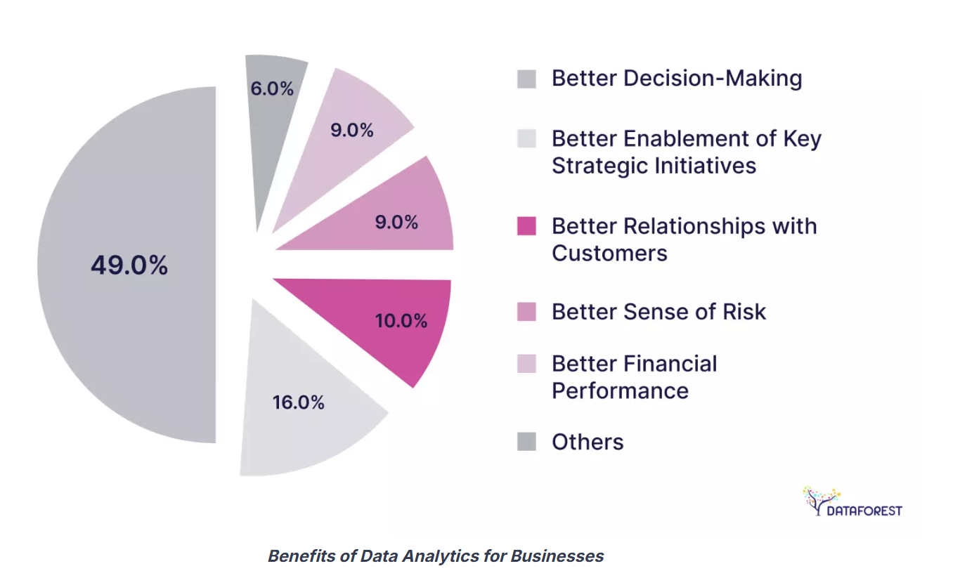
Importance of news analytics & business value
➤ What is News Analytics?
The process of collecting, processing, and analyzing news articles and media content.
Extracts meaningful insights from large volumes of text data.
➤ Why is it Important?
Helps understand public sentiment and trending topics in real time.
Enables businesses to anticipate market changes, reputation risks, and consumer behavior.
Provides early warnings for events impacting industries, competitors, or financial markets.
➤ Business Value
Informed Decision-Making: Empowers organizations to make data-driven decisions based on public narratives.
Brand Reputation Management: Tracks sentiment to protect and improve brand image.
Market Intelligence: Identifies emerging opportunities and risks by analyzing news trends.
Competitive Advantage: Gains insights into competitors through media coverage analysis.
I loaded the dataset that I collected from the New York Times API and performed an initial inspection to preview the data and check for missing values. This helped ensure the dataset was clean and ready for further processing.

Slide 3
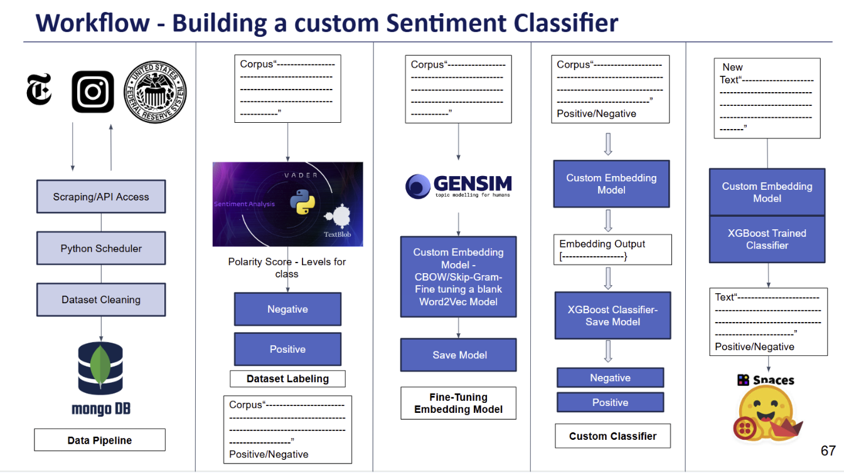

Slide 4
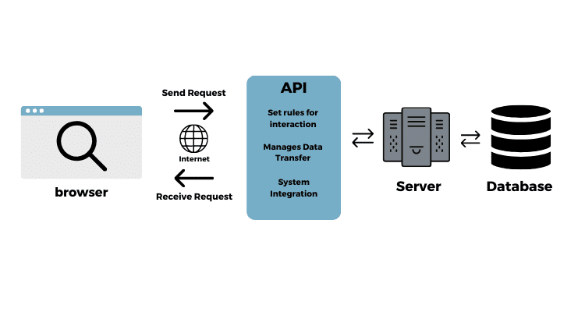
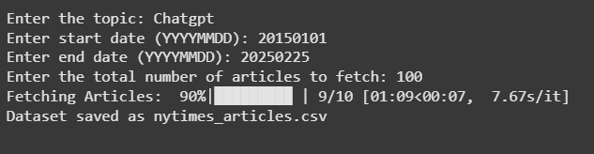

Data Collection Using the NYTimes API
Ensured data completeness by pacing API requests to comply with rate limits.
Saved the dataset as nytimes_articles.csv for further analysis.
Topic/Keyword: User-defined (e.g., AI advancements, Climate Change, Elon Musk).
Date Range: Start and end dates were specified by the user (YYYYMMDD format).
Pagination: Fetched multiple pages to retrieve the desired number of articles.
API Key: Secured access through an authorized NYTimes API key.
Collected data directly from the New York Times Article Search API.
Collected articles based on user-defined topics, date range, and desired article count.

Slide 5
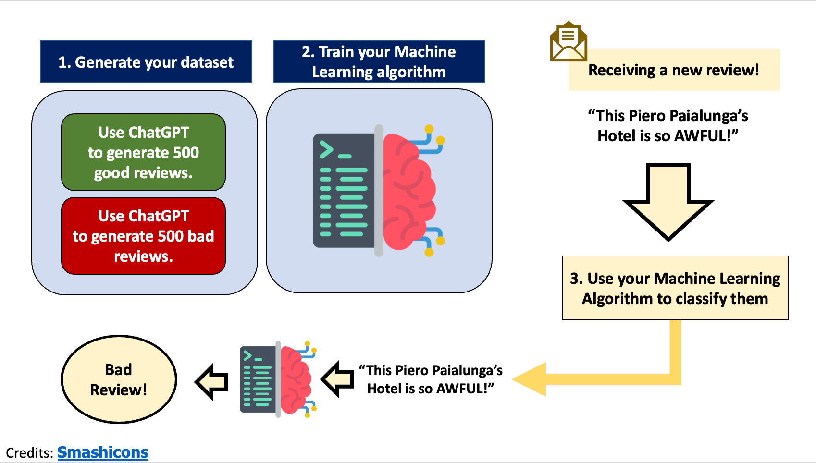
This illustration demonstrates the core concept of sentiment analysis applied to news articles:
Data Generation & Collection: Similar to generating reviews, we collected news articles from The New York Times API, covering both positive and negative sentiments.
Training the Model: We processed the text data and trained machine learning models to classify article sentiments, focusing on public opinion and trends in AI-related news.
Real-Time Classification: The trained model helps classify new articles as positive, negative, or neutral, providing actionable insights for businesses and stakeholders to understand public sentiment.

Slide 6
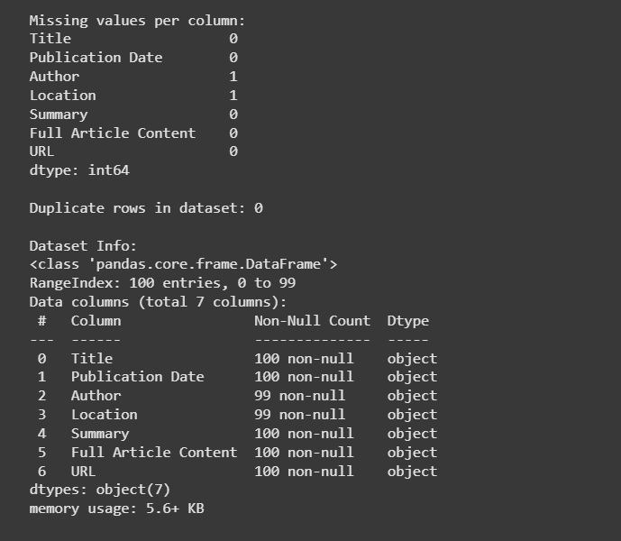
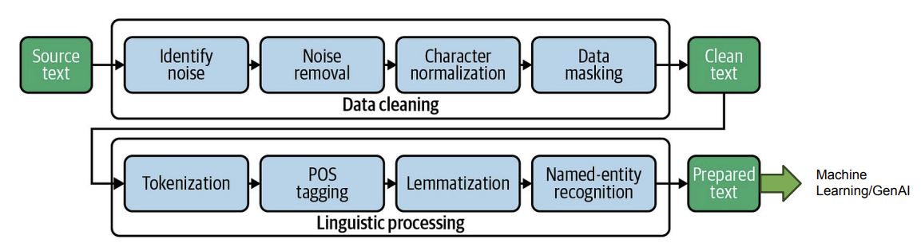
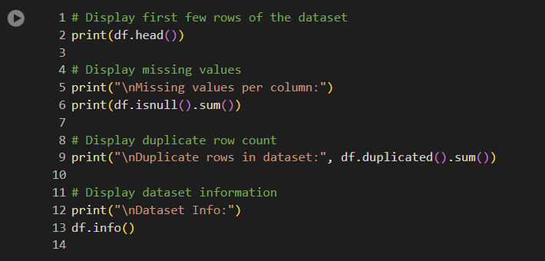
Dataset Overview & Initial Inspection
Saved as: nytimes_articles.csv for further analysis.
Extracted key fields from each article, including: ➤ Title ➤ Publication Date ➤ Author ➤ Location ➤ Summary ➤ Full Article Content ➤ URL
Dataset Information
Inspected the overall dataset structure, including data types and non-null counts.
Confirmed a total of 100 records with 7 key columns, all stored as object types.
Missing Values Check
Checked for missing values in each column.
Found that a small number of records were missing Author and Location information, but the dataset was mostly complete.
Prof. Arup

Slide 7
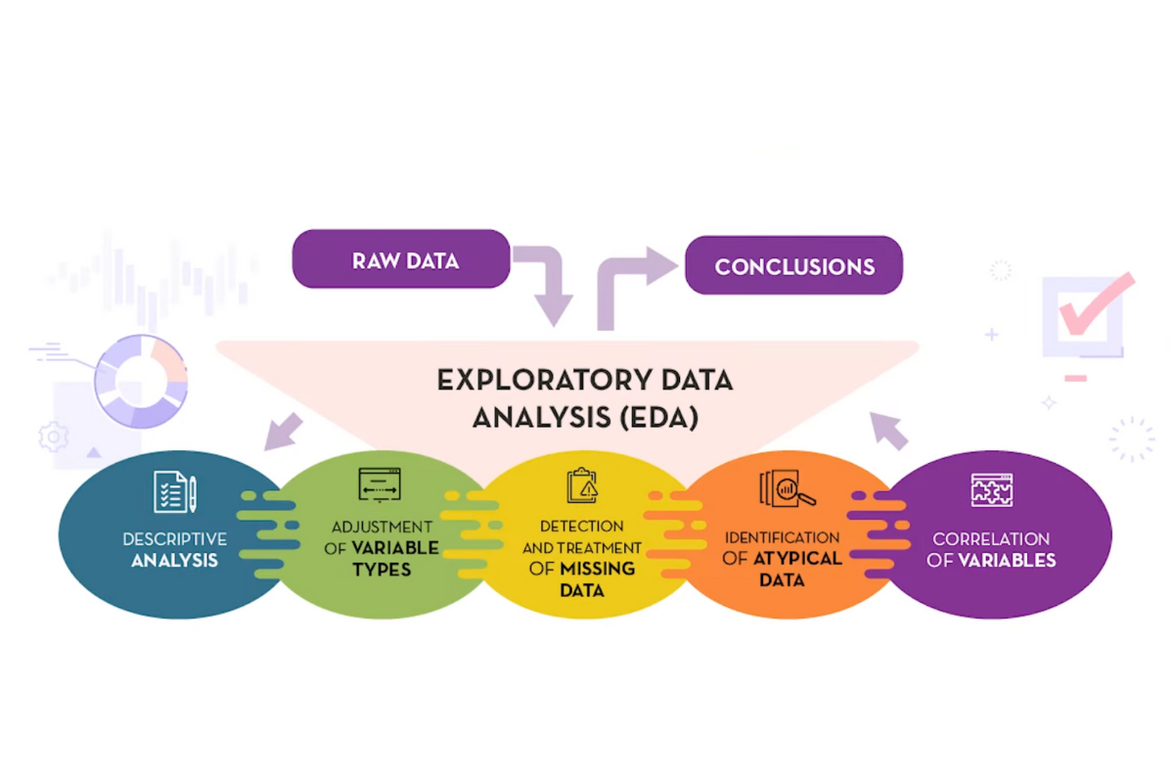
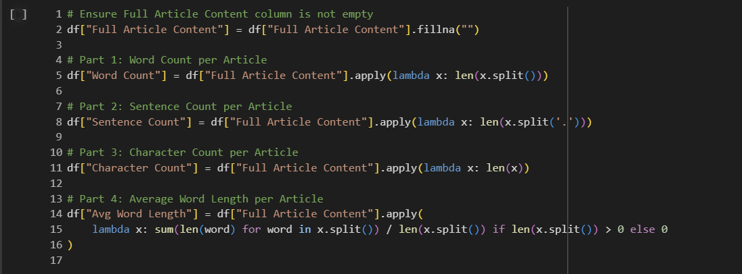
Exploratory Data Analysis – Key statistics & visualizations
Feature Engineering for Text Analysis
Performed exploratory data analysis (EDA) on the Full Article Content to generate key statistics.
Created new numerical features to better understand the structure and complexity of each article.
➤ Key Statistics Computed:
Word Count: Total number of words in each article.
Sentence Count: Number of sentences estimated by periods.
Character Count: Total number of characters, providing insight into article length.
Average Word Length: Measures the average length of words, giving an idea of the writing style (complex vs. simple).

Slide 8
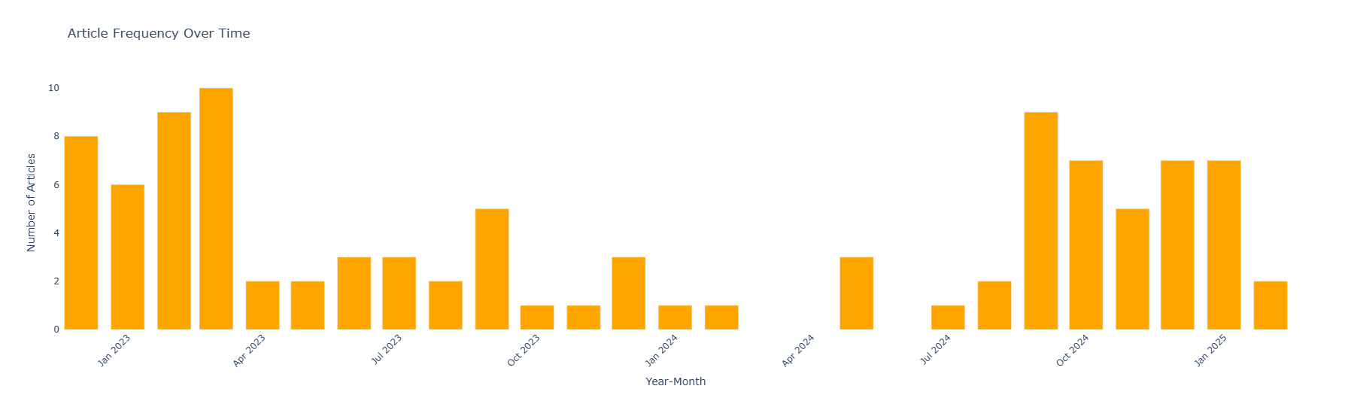
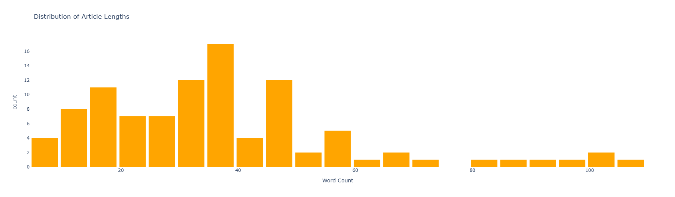
Article Frequency Over Time
Distribution of Article Lengths
This bar chart visualizes the number of articles published each month over the last two years.
We can observe clear fluctuations in publishing frequency, with certain months (e.g., early 2023 and late 2024) seeing notable spikes in publication volume.
These peaks may indicate periods of heightened media attention on key topics, possibly driven by major events or public interest surges.
Conversely, months with lower publication counts suggest times when less content was generated or lower focus on the queried themes.
The majority of articles have word counts ranging between 20 to 50 words, indicating that most content is concise and to the point.
There is a noticeable drop-off in frequency as article length increases, with relatively few long-form articles exceeding 80 to 100 words.
This suggests a preference for shorter, more digestible content in the dataset, which aligns with modern reader engagement trends.

Slide 9
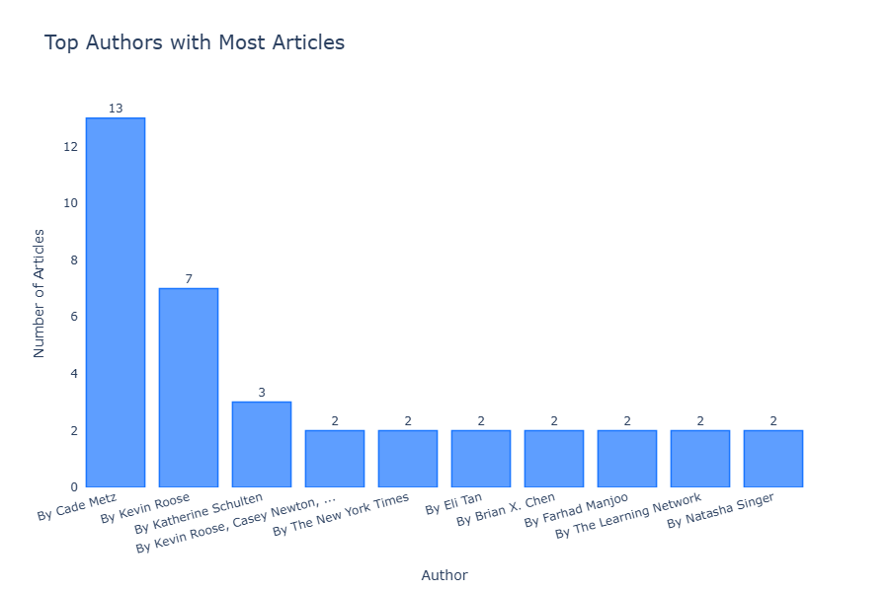
Top Authors with the Most Articles
Identifying top authors helps understand who drives the majority of content creation and potentially shapes the narrative around the selected topic.
This insight is valuable for businesses aiming to collaborate with influential writers, monitor author-specific trends, or analyze author biases.
It also provides a clear view of content diversity, showing whether information comes from a broad range of voices or is concentrated among a few key contributors.

Slide 10
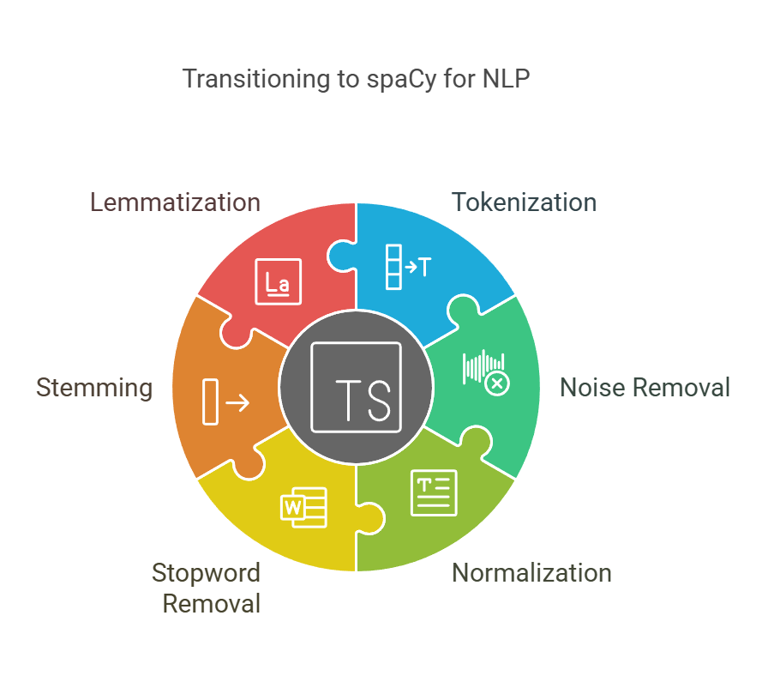
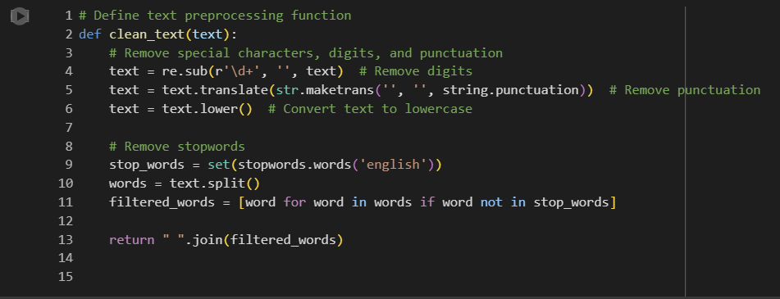
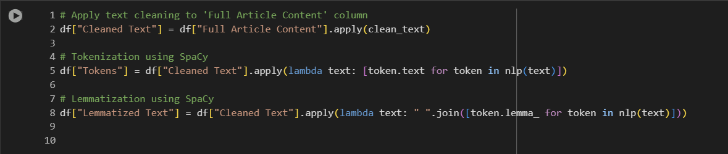
Text Preprocessing – Tokenization, cleaning, stopword removal
Key Steps in Preprocessing
Text Cleaning
Removed unnecessary elements like digits, punctuation, and special characters.
Converted all text to lowercase for uniformity.
Stopword Removal
Eliminated common words (e.g., "the", "is", "in") that do not contribute meaningful insights.
Tokenization (Using SpaCy)
Broke the cleaned text into individual words (tokens), which makes it easier to analyze and process.
Lemmatization (Using SpaCy)
Reduced each word to its root form, ensuring that different forms of a word (e.g., "running", "ran") are treated the same.

Slide 11
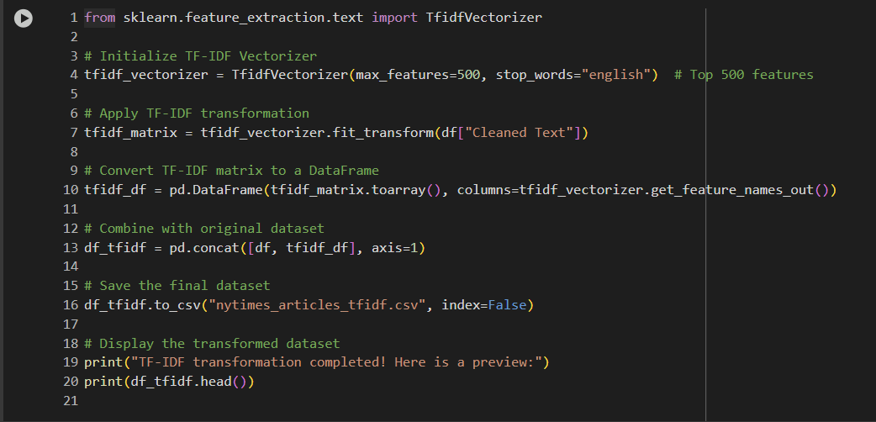
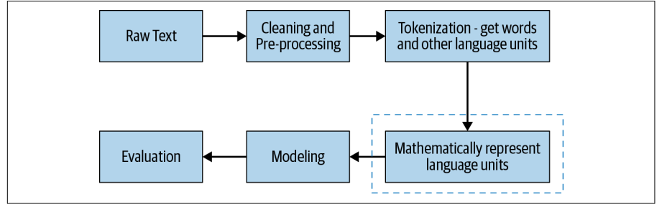
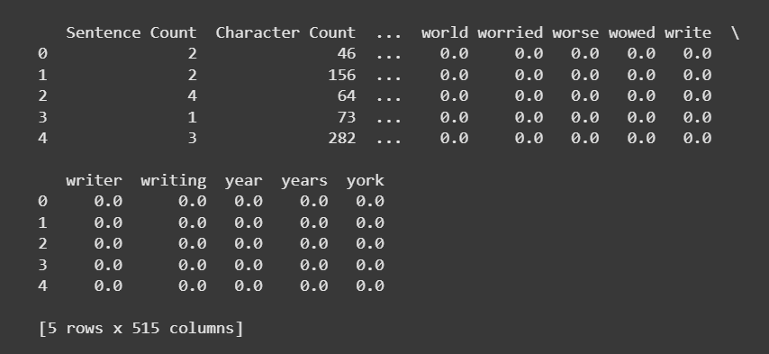
Feature Engineering – Word counts, sentence counts, TF-IDF
Extracted the top 500 most important features from the cleaned text data.
TF-IDF helped in weighing the terms based on their relevance—common words were down-weighted, while informative terms received higher weights.
Transformed data was merged with the original dataset for advanced machine learning tasks.
The numerical values indicate the importance of each word within a specific article.
This structured representation enables effective text analysis, classification, and topic modeling.

Slide 12

Harnessing the News Data Deluge
55%
24/7
Dark Data
Continuous Analysis
Percentage of organizational data that remains unused or undiscovered.
Real-time processing of global news sources without interruption.
∞
Scalable Processing
AI and machine learning enable unlimited processing capacity.
News analytics transforms unstructured information into actionable business intelligence.

Slide 13
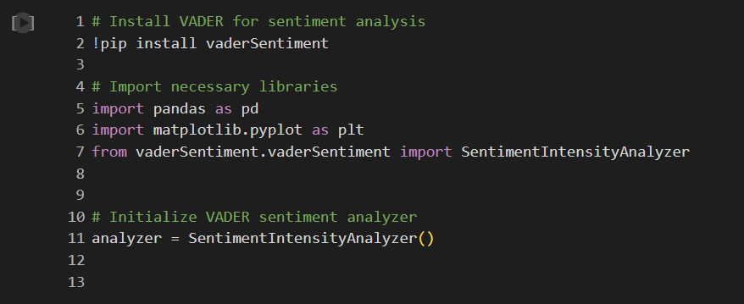
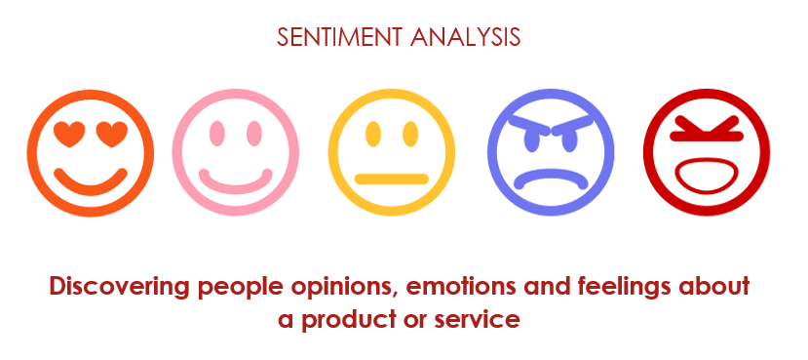
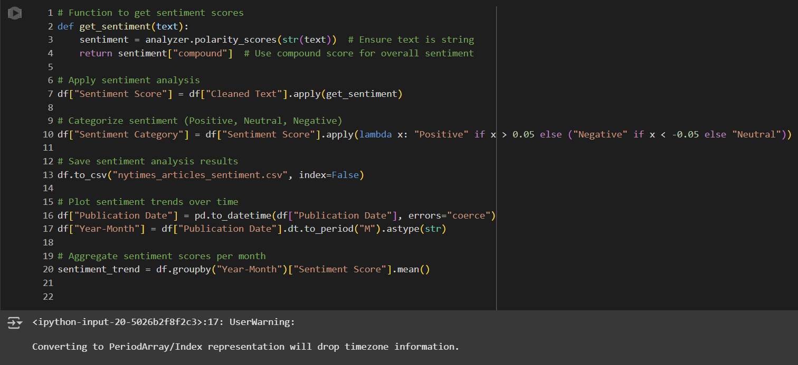
Sentiment Analysis – Trends & key findings
I used the VADER SentimentIntensityAnalyzer to calculate the sentiment score (compound score) for each article from the dataset. This score ranges from -1 (most negative) to +1 (most positive).
Performed sentiment analysis on ChatGPT-related news articles using the VADER Sentiment Analyzer.
Assigned each article a sentiment score and categorized it as Positive, Negative, or Neutral.
Aggregated sentiment scores by month to observe trends over time.
Identified key periods where public perception of ChatGPT was notably positive or negative.
These insights help understand media sentiment shifts and public opinion dynamics related to ChatGPT.
Based on the compound score, each article was classified as: ➤ Positive (score > 0.05) ➤ Negative (score < -0.05) ➤ Neutral (score between -0.05 and 0.05)

Slide 14
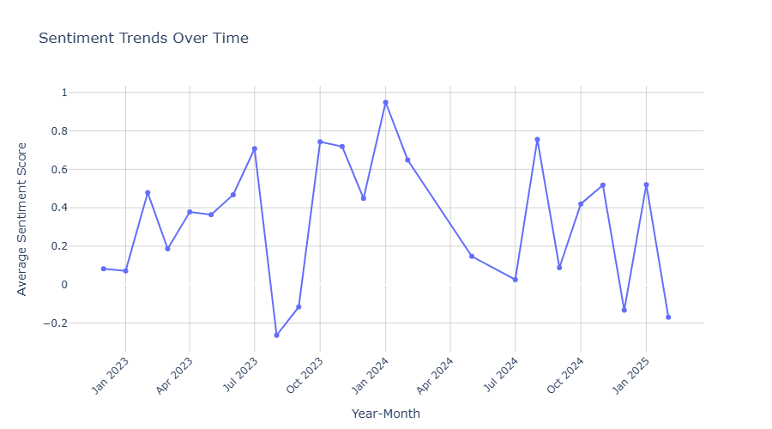
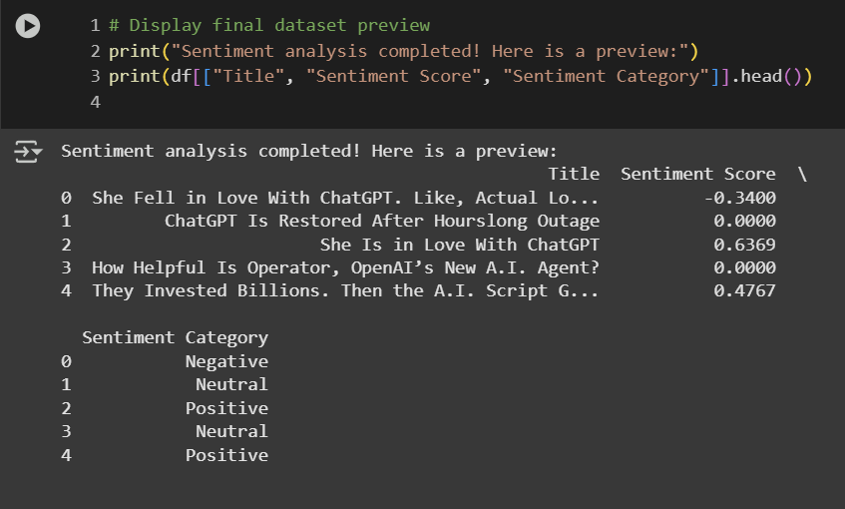
Sentiment Trends Over Time
The monthly average sentiment score of ChatGPT-related articles over the analyzed time period.
The trend shows fluctuations in public perception, with noticeable peaks and dips corresponding to key events or media coverage involving ChatGPT.
Positive sentiment peaks indicate periods of optimism and favorable media attention, while the dips reflect times of criticism, controversy, or concerns related to AI and ChatGPT.
Overall, the analysis highlights how sentiment towards ChatGPT has varied over time, providing valuable insights into public opinion and engagement trends.

Slide 15
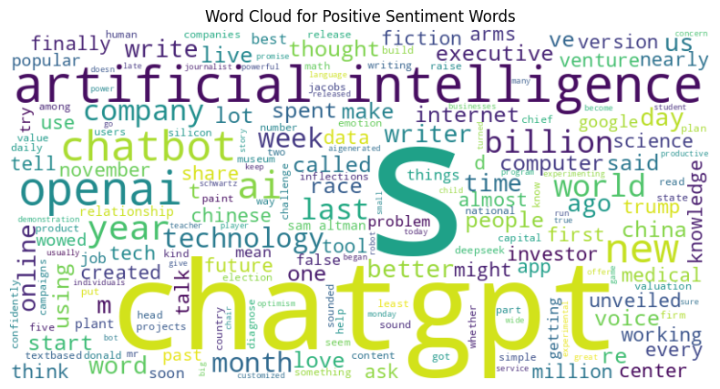
Positive Sentiment Word Cloud Insights
The positive word cloud highlights terms like "ChatGPT," "artificial intelligence," "openAI," "future," "technology," and "innovation."
This indicates a strong association of ChatGPT with progress, technological advancement, and optimistic discussions around AI capabilities.
Positive articles often focus on ChatGPT’s impact on productivity, education, and technological innovation.

Slide 16
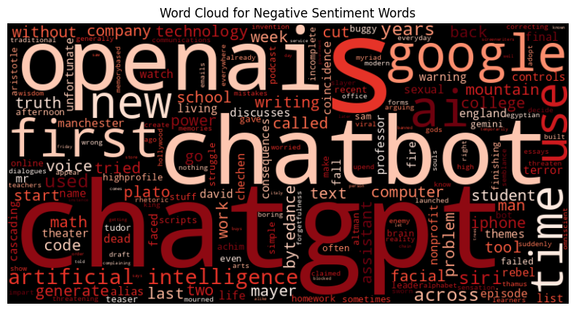
Negative Sentiment Word Cloud Insights
The negative word cloud displays terms like "chatGPT," "problem," "concerns," "limitations," "buggy," and "privacy."
Discussions often revolve around ethical concerns, misinformation, job displacement, and privacy issues.
Negative sentiment highlights the need for better regulation, transparency, and user trust in AI technology.

Slide 17
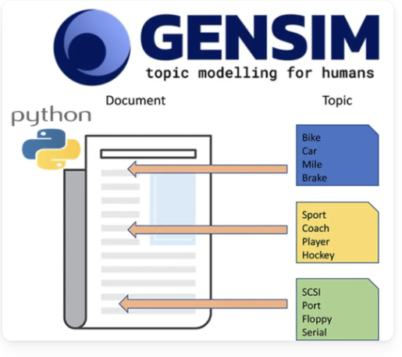
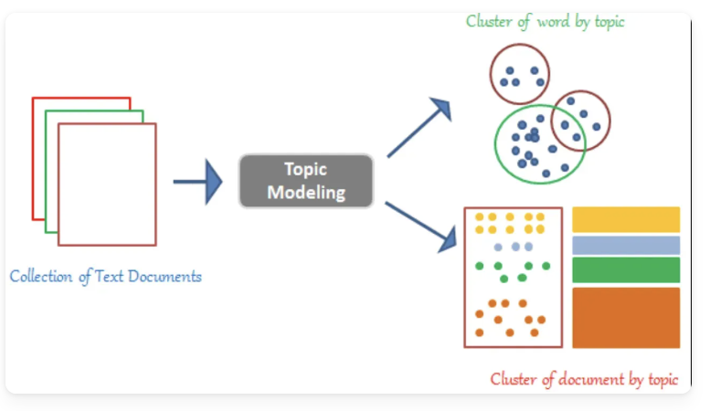
Topic Modeling – Key topics, trends, and insights
What is Topic Modeling? Topic modeling is an unsupervised machine learning technique used to automatically identify and extract the underlying themes or "topics" present in a large collection of text documents. It helps organize, understand, and summarize textual data by grouping similar words and documents based on these themes.
How Topic Modeling Works:
Preprocessed Data Input
After cleaning and preparing dataset, the documents are tokenized and converted into numerical format.
Gensim LDA Model
Gensim’s LDA (Latent Dirichlet Allocation) model processes the articles and identifies topics by clustering words that frequently occur together.
Clusters/Topics Output
As shown in the images:
Words are grouped into clusters representing topics.
Documents are tagged based on their dominant topic.
For example, one article might be about "AI technology", while another focuses on "ChatGPT ethics".
Business Value
This helps us to track what the media and public are focusing on about ChatGPT over time, informing content strategies, product improvements, or policy considerations.

Slide 18
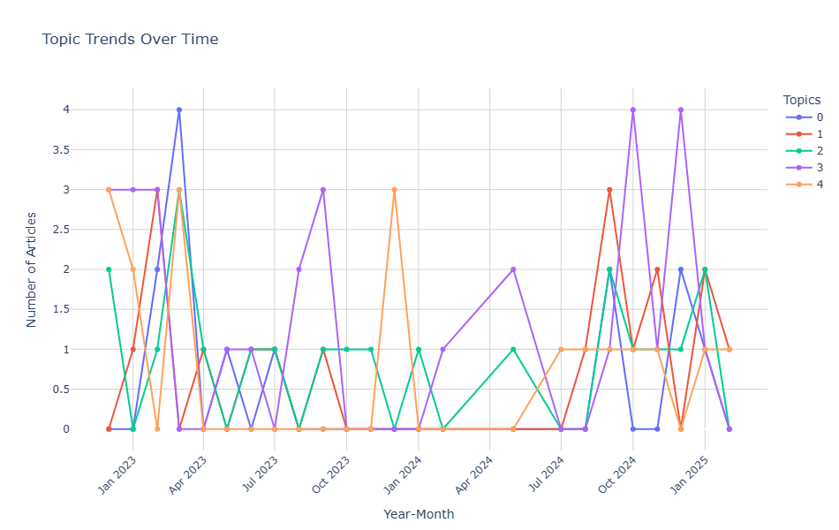
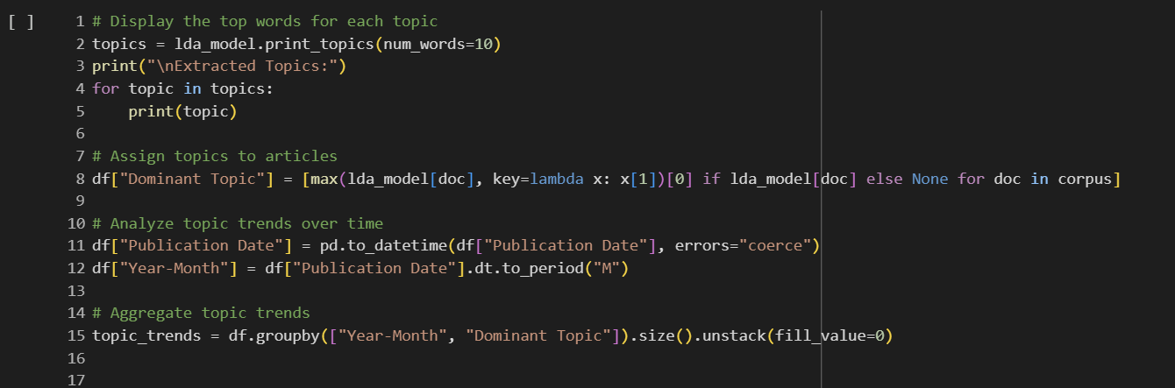
Applied LDA to extract 5 key topics from ChatGPT-related articles, covering themes like AI advancements, ethics, and user experiences.
Analyzed topic trends over time by assigning each article its dominant topic.
Insights:
Topic 3 peaked in late 2023, reflecting major events or updates in ChatGPT.
Topics 1 and 4 remained steady, highlighting ongoing discussions on ethics and user concerns.
These trends help identify emerging topics, guide business strategies, and track public interest over time.

Slide 19
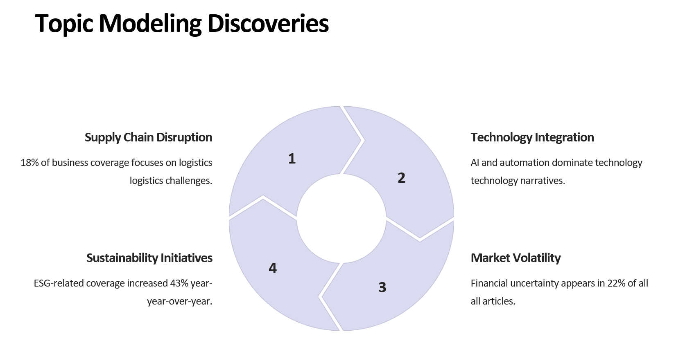

Slide 20

https://colab.research.google.com/drive/1fAIWNgv5TZl6E_oi_OdFtJRumGqRjJFr?usp=sharing

Slide 21

Best Practices for Implementation
Define Clear Objectives
Establish specific business goals and use cases before implementation.
Build Robust Infrastructure
Invest in scalable data systems and powerful analytics tools.
Cultivate Data Culture
Promote data literacy and evidence-based decision making organization-wide.
Continuously Refine
Regularly validate and improve analytics models with new data.

Slide 22





Applications Across Industries
Finance
Marketing
Corporate Strategy
Trading strategies, risk assessment, and market sentiment analysis for investment decisions.
Brand perception tracking, campaign effectiveness measurement, and emerging trend identification.
M&A opportunity discovery, competitive landscape analysis, and market positioning.
Public Relations
Crisis management, media impact evaluation, and proactive reputation defense.

Slide 23





The Future of News Analytics
Advanced NLP
Natural language processing will understand context, emotion, and nuance with human-like comprehension.
Multi-source Integration
Seamless combination of news with social media, IoT, and proprietary data.
Predictive Capabilities
Forecasting business outcomes through sophisticated scenario modeling.
Democratized Access
User-friendly tools will make powerful analytics available to all employees.

